Slide 1

When to use first differences or fixed effects? And how to deal with residuals serially correlated as an AR(1)
Felipe Buchbinder

Slide 2

Before we begin: What is an AR(1) process?
$$ε_{t}=ρ⋅ε_{t−1}+ν_{t} \\ ν_{t}\sim N\left(0,σ^{2}\right) \\ \left|ρ\right|<1$$

Slide 3


Before we begin: What is an AR(1) process?
$$ε_{t}=ρ⋅ε_{t−1}+ν_{t} \\ ν_{t}\sim N\left(0,σ^{2}\right) \\ \left|ρ\right|<1$$
In most practical applications,
$$ρ≻0$$
(Why?)

Slide 4
Testing for Serial correlation
Durbin-Whatson Statistic
Breusch-Godfrey Lagrange Multiplier test

Slide 5
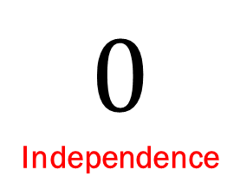
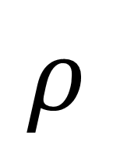


Borderline cases
$$ε_{t}=ρ⋅ε_{t−1}+ν_{t} \\ ν_{t}\sim N\left(0,σ^{2}\right) \\ \left|ρ\right|<1$$
$$0$$
Independence
$$1$$
Random Walk
$$ρ$$

Slide 6
Borderline cases
$$ε_{t}=ρ⋅ε_{t−1}+ν_{t} \\ ν_{t}\sim N\left(0,σ^{2}\right) \\ \left|ρ\right|<1$$
$$0$$
Independence
$$1$$
Random Walk
$$ρ$$
OLS works well
when residuals are here

Slide 7
Fixed effects or first difference?
$$ε_{t}=ρ⋅ε_{t−1}+ν_{t} \\ ν_{t}\sim N\left(0,σ^{2}\right) \\ \left|ρ\right|<1$$
$$0$$
Independence
$$1$$
Random Walk
$$ρ$$
If FE residuals lie here,
used Fixed Effects
If FE residuals lie here,
Use First Differences

Slide 8
Fixed effects or first difference?
$$ε_{t}=ρ⋅ε_{t−1}+ν_{t} \\ ν_{t}\sim N\left(0,σ^{2}\right) \\ \left|ρ\right|<1$$
$$0$$
Independence
$$1$$
Random Walk
$$ρ$$
If FE residuals lie here,
used Fixed Effects
What if FE residuals
lie here?
If FE residuals lie here,
Use First Differences

Slide 9
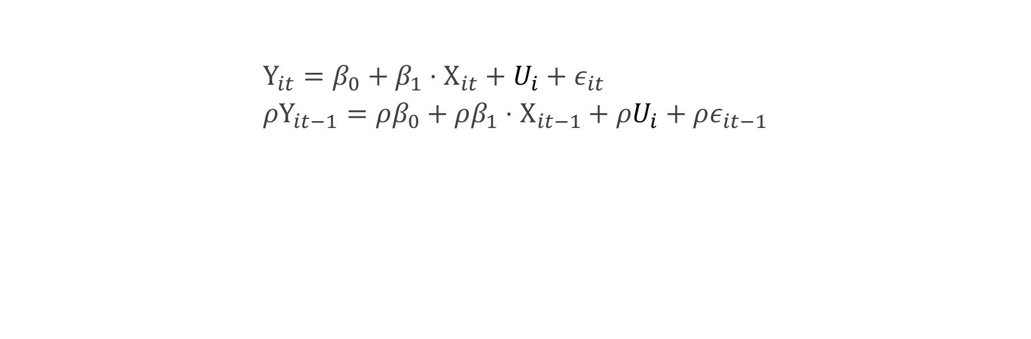
If we know the AR(1) structure, we can make serially independent This process is called quasi-differentiation
$$Y_{it}=β_{0}+β_{1}⋅X_{it}+U_{i}+ε_{it} \\ {ρY}_{it−1}=ρβ_{0}+ρβ_{1}⋅X_{it−1}+ρU_{i}+ρε_{it−1}$$
$$Y_{it}−ρY_{it−1}=β_{0}\left(1−ρ\right)+β_{1}⋅\left(X_{it}−ρX_{it−1}\right)+{\left(1−ρ\right)U}_{i}+\left(ε_{it}−ρε_{it−1}\right)$$

Slide 10
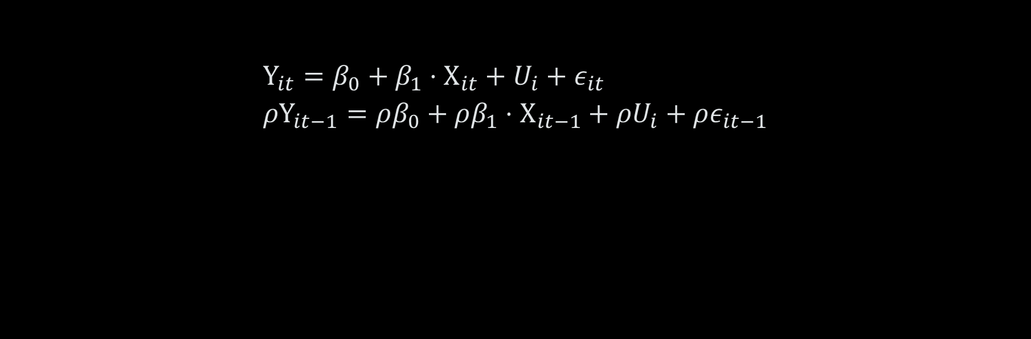
we now have a model where residuals are serially independent…
$$Y_{it}=β_{0}+β_{1}⋅X_{it}+U_{i}+ε_{it} \\ {ρY}_{it−1}=ρβ_{0}+ρβ_{1}⋅X_{it−1}+ρU_{i}+ρε_{it−1}$$
$$Y_{it}−ρY_{it−1}=β_{0}\left(1−ρ\right)+β_{1}⋅\left(X_{it}−ρX_{it−1}\right)+{\left(1−ρ\right)U}_{i}+\left(ε_{it}−ρε_{it−1}\right)$$
$$Y_{it}−ρY_{it−1}=β_{0}\left(1−ρ\right)+β_{1}⋅\left(X_{it}−ρX_{it−1}\right)+{\left(1−ρ\right)U}_{i}+ν_{it}$$

Slide 11

But how do we know the value of $ρ$? 2 very similar approaches and one slightly different…
Cochrane-Orcutt estimation
Prais-Winsten estimation
Hildreth-Lu estimation

Slide 12
Problem: we haven’t eliminated the unobserved heterogeneity (Though we might have made it smaller, which is already a good thing!)
$$Y_{it}=β_{0}+β_{1}⋅X_{it}+U_{i}+ε_{it} \\ {ρY}_{it−1}=ρβ_{0}+ρβ_{1}⋅X_{it−1}+ρU_{i}+ρε_{it−1}$$
$$Y_{it}−ρY_{it−1}=β_{0}\left(1−ρ\right)+β_{1}⋅\left(X_{it}−ρX_{it−1}\right)+{\left(1−ρ\right)U}_{i}+\left(ε_{it}−ρε_{it−1}\right)$$
$$Y_{it}−ρY_{it−1}=β_{0}\left(1−ρ\right)+β_{1}⋅\left(X_{it}−ρX_{it−1}\right)+{\left(1−ρ\right)U}_{i}+ν_{it}$$

Slide 13
Special case: When residuals follow a random walk, we get the first differences model It works: we have no heterogeneities and serially uncorrelated residuals
$$Y_{it}=β_{0}+β_{1}⋅X_{it}+U_{i}+ε_{it} \\ {ρY}_{it−1}=ρβ_{0}+ρβ_{1}⋅X_{it−1}+ρU_{i}+ρε_{it−1}$$
$$Y_{it}−ρY_{it−1}=β_{0}\left(1−ρ\right)+β_{1}⋅\left(X_{it}−ρX_{it−1}\right)+{\left(1−ρ\right)U}_{i}+\left(ε_{it}−ρε_{it−1}\right)$$
$$Y_{it}−1Y_{it−1}=β_{0}\left(1−1\right)+β_{1}⋅\left(X_{it}−1X_{it−1}\right)+{\left(1−1\right)U}_{i}+ν_{it}$$

Slide 14


Key takeaways
Fixed Effects Models work well when residuals are serially independent ($ρ=0$)
First Difference Models work well when residuals follow a Random Walk ($ρ=1$)
Both independence and Random Walk are borderline cases of AR(1) processes
When residuals follow a general AR(1) process, this can be corrected by quasi-differentiation.
To know if residuals follow an AR(1) process, we can use the Breusch-Godfrey test or the Durbin-Whatson statistic.
Quasi-differentiation requires estimating $ρ$. This can be done using Cochrane-Orcutt, Prais-Winsten or Hildreth-Lu estimation algorithms
Quasi-differentiation makes residuals serially uncorrelated but does not completely eliminate the unobserved heterogeneity (though it might make it weaker)
In most real-world cases of residuals following an AR(1) process, $ρ$ is positive.

